Slide 1


E-commerce Behavior
Fall 2020 CIS 5200 | Systems Analysis & Design Professor | Jongwook Woo
David Gómez Tagle | Jonathan B. Reyes | Jose Ramirez | Jing Zhu | Kelvin Odii

Slide 2
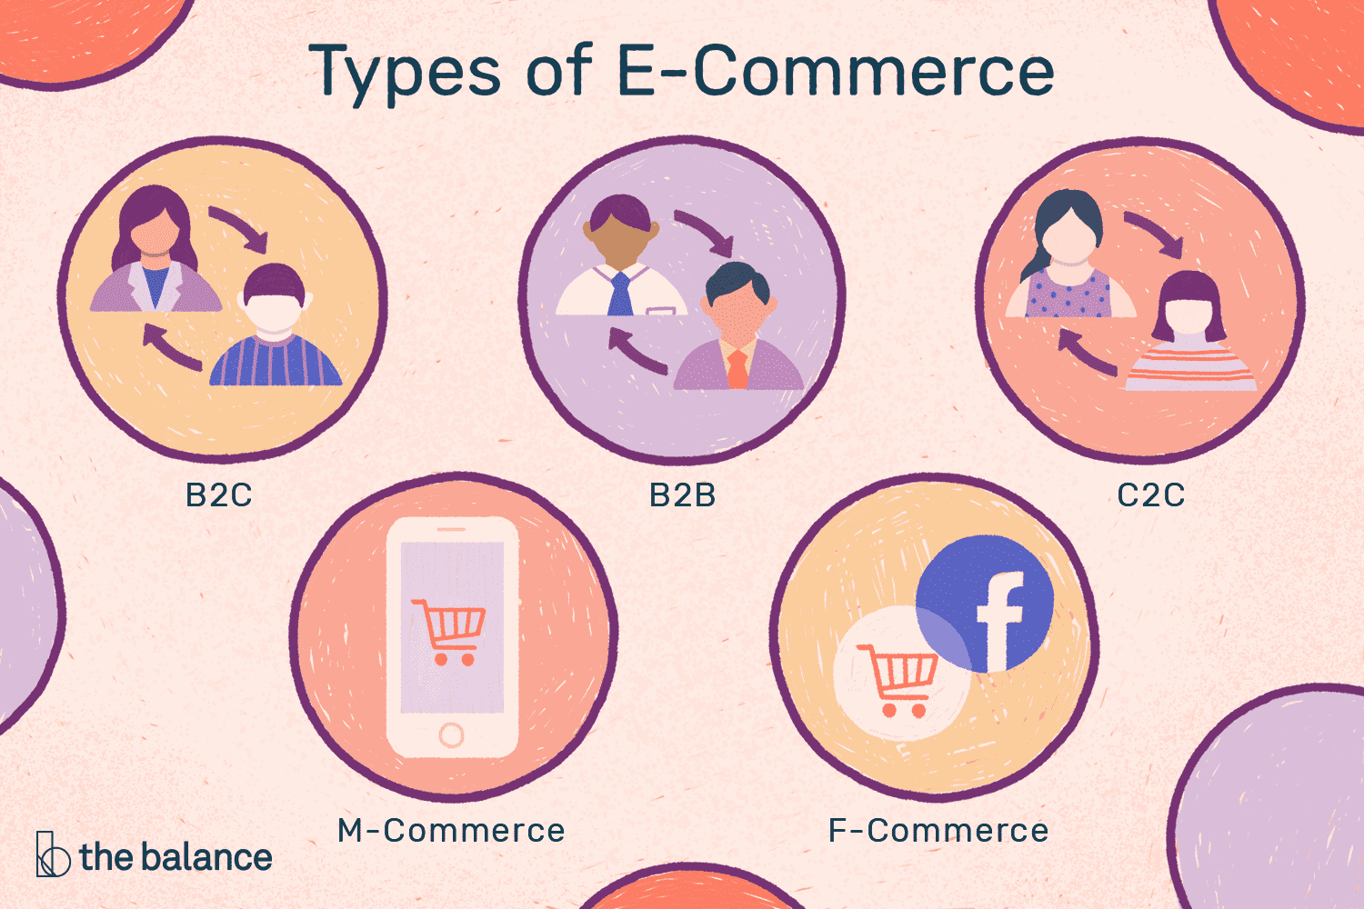
Introduction
Ecommerce Behavior:
Size: 43.10 GB
Record count: 310,190,105
7 months of behavior data related to products Purchased, Categories, and Date / Time purchase.
From the Data:
Analyze consumer behavior
Identify categories most purchased
When they are likely to be purchased
Benefits:
By Identify Categories, Items Purchased, and Time of purchase, we can provide a valuable analysis for marketing efforts in the ecommerce industry
.
event_time
event_type
category_code
loud analytics and cloud visualization were implementing projects in eCommerce on customer behavior with social media cases. How it can attract more shoppers and improving the shopping experience to meet consumer satisfaction.

Slide 3
DATASET
Field Name | Data Type
event_time | STRING
event_type | STRING
product_id | BIGINT
category_id | BIGINT
category_code | STRING
brand | STRING
price | FLOAT
user_id | BIGINT
user_session | STRING
Utilizing the highlighted fields, we are able to create the following insights:
What are the top 10 purchased categories?
What are top 10 items purchased of the top category ?
What time of day are these items mostly purchased?

Slide 4

Hardware Specs
Component | Details
Cluster Version: | 20.3.3-20
Number of Nodes | 3
CPU Speed: | 12 OCPU
Memory Size: | 180GB

Slide 5
Relevant Work
Consumers are influenced by Social Media are 4 more times likely to spend more on purchases online.
The influence of Social Media and E-Commerce are so high that 29% of consumers are likely to make a purchase on the same day of using social media.
Facebook - “Liking” Feature of Facebook in how it impacts Consumer Behavior” 1. It acknowledge the gratifications of “likes” 2. Share Information with others 3. Social Obligations - Likes are plugged into more than 10 M websites globally 4. Many Companies and organization have integrated a FB platform into their website.

Slide 6
Relevant Work - cont...
“3 Findings That Prove Instagram Drives Shopping Behavior”
IG - That companies are “Branding Their Product on Instagram can have a Positive Impact” on audiences perceive on branding and on consumer behavior.
That consumers view brands more “Popular 78%, Relevant 74%, Creative 77%, Entertaining 76%, and committed to building a Community 72% that those are not.
The study found that just your brand simply being on Instagram can have a positive impact on how audience perceive your brand.

Slide 7
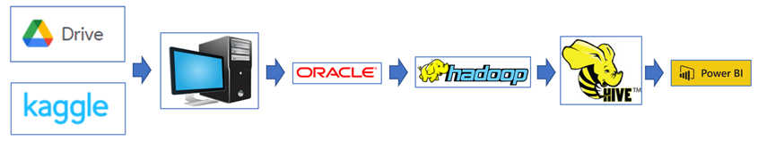
Implementation
Workflow
Data downloaded from Kaggle and Google Drive
CSV files were split and compressed locally (Desktop)
Files uploaded to Oracle and uncompressed
Files moved to HDFS file directory
HiveQL utilized for schema development and data analysis
Data visualized vis Power BI

Slide 8

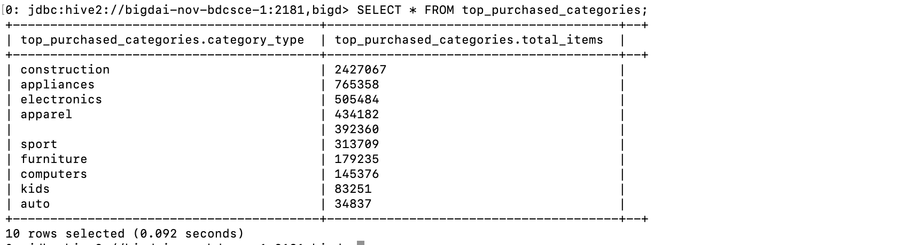
Data Query & Analysis
Our first step was to identify the top categories that were purchased. Within Hive:
Create a table: top_purchased_categories & ran query
Utilized REGEXP_EXTRACT for pattern matching
We learn that “Construction” is the top purchased category

Slide 9
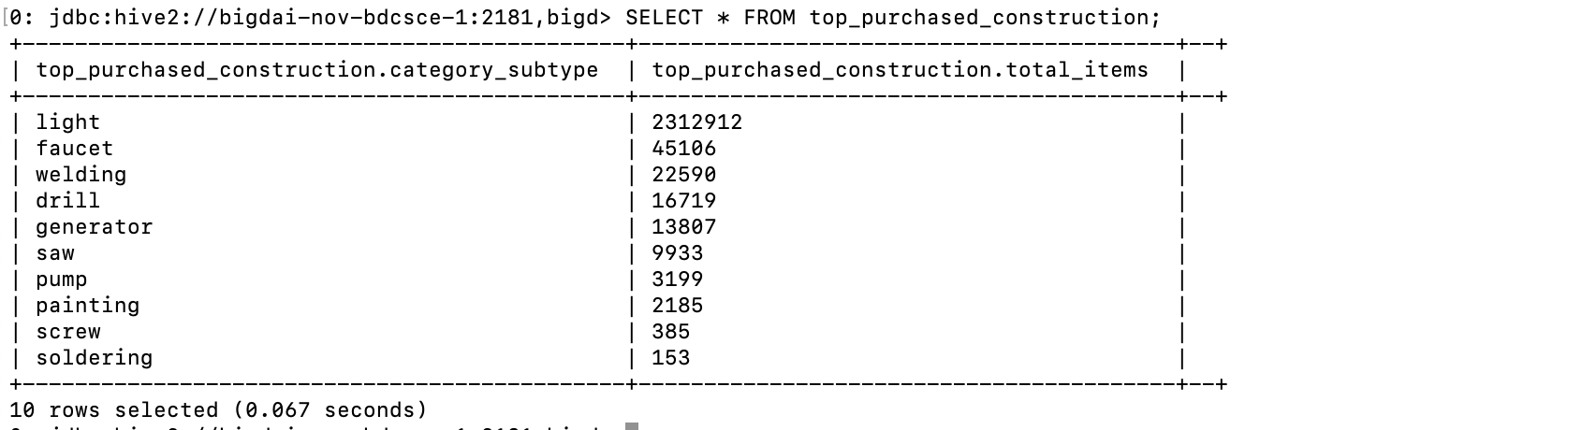
Data Query & Analysis - cont...
Secondly, we want to understand what sub_category of “Construction is purchased most
Create a table: top_purchased_construction & run query
Utilized REGEXP_EXTRACT for pattern matching
We learn that “lights” are the top purchases items of “Construction”

Slide 10
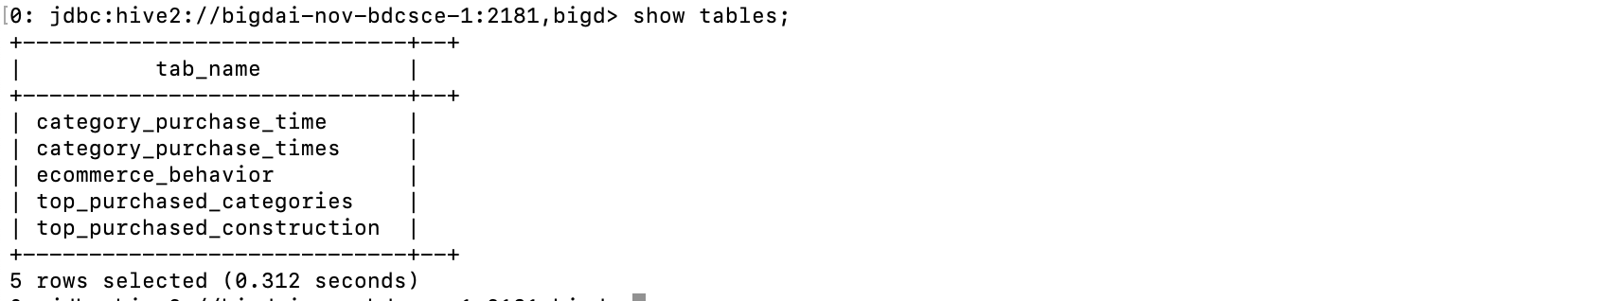
Data Query & Analysis - cont...
Lastly, we identified a value as to know when these items are purchased
Create table: category_purchase_time
Utilized REGEXP_EXTRACT to match “purchase”
Now that we have created the tables, we download them locally and import them into PowerBi to create our visualizations.

Slide 11
Visualizations
Microsoft PowerBI
What are the top 10 purchased categories?
What are top 10 items purchased of the top category ?
What time of day are these items mostly purchased?

Slide 12
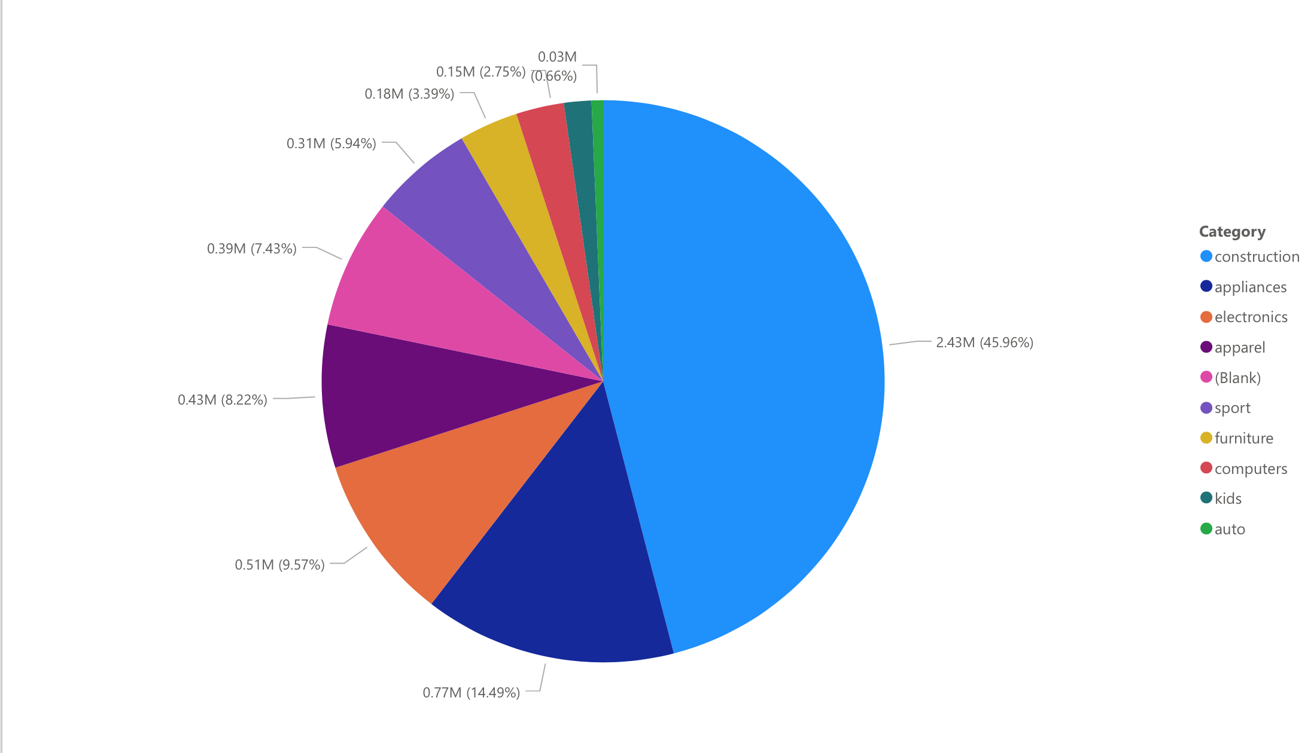
45.96% of purchases (2.43 Million) are of construction

Slide 13
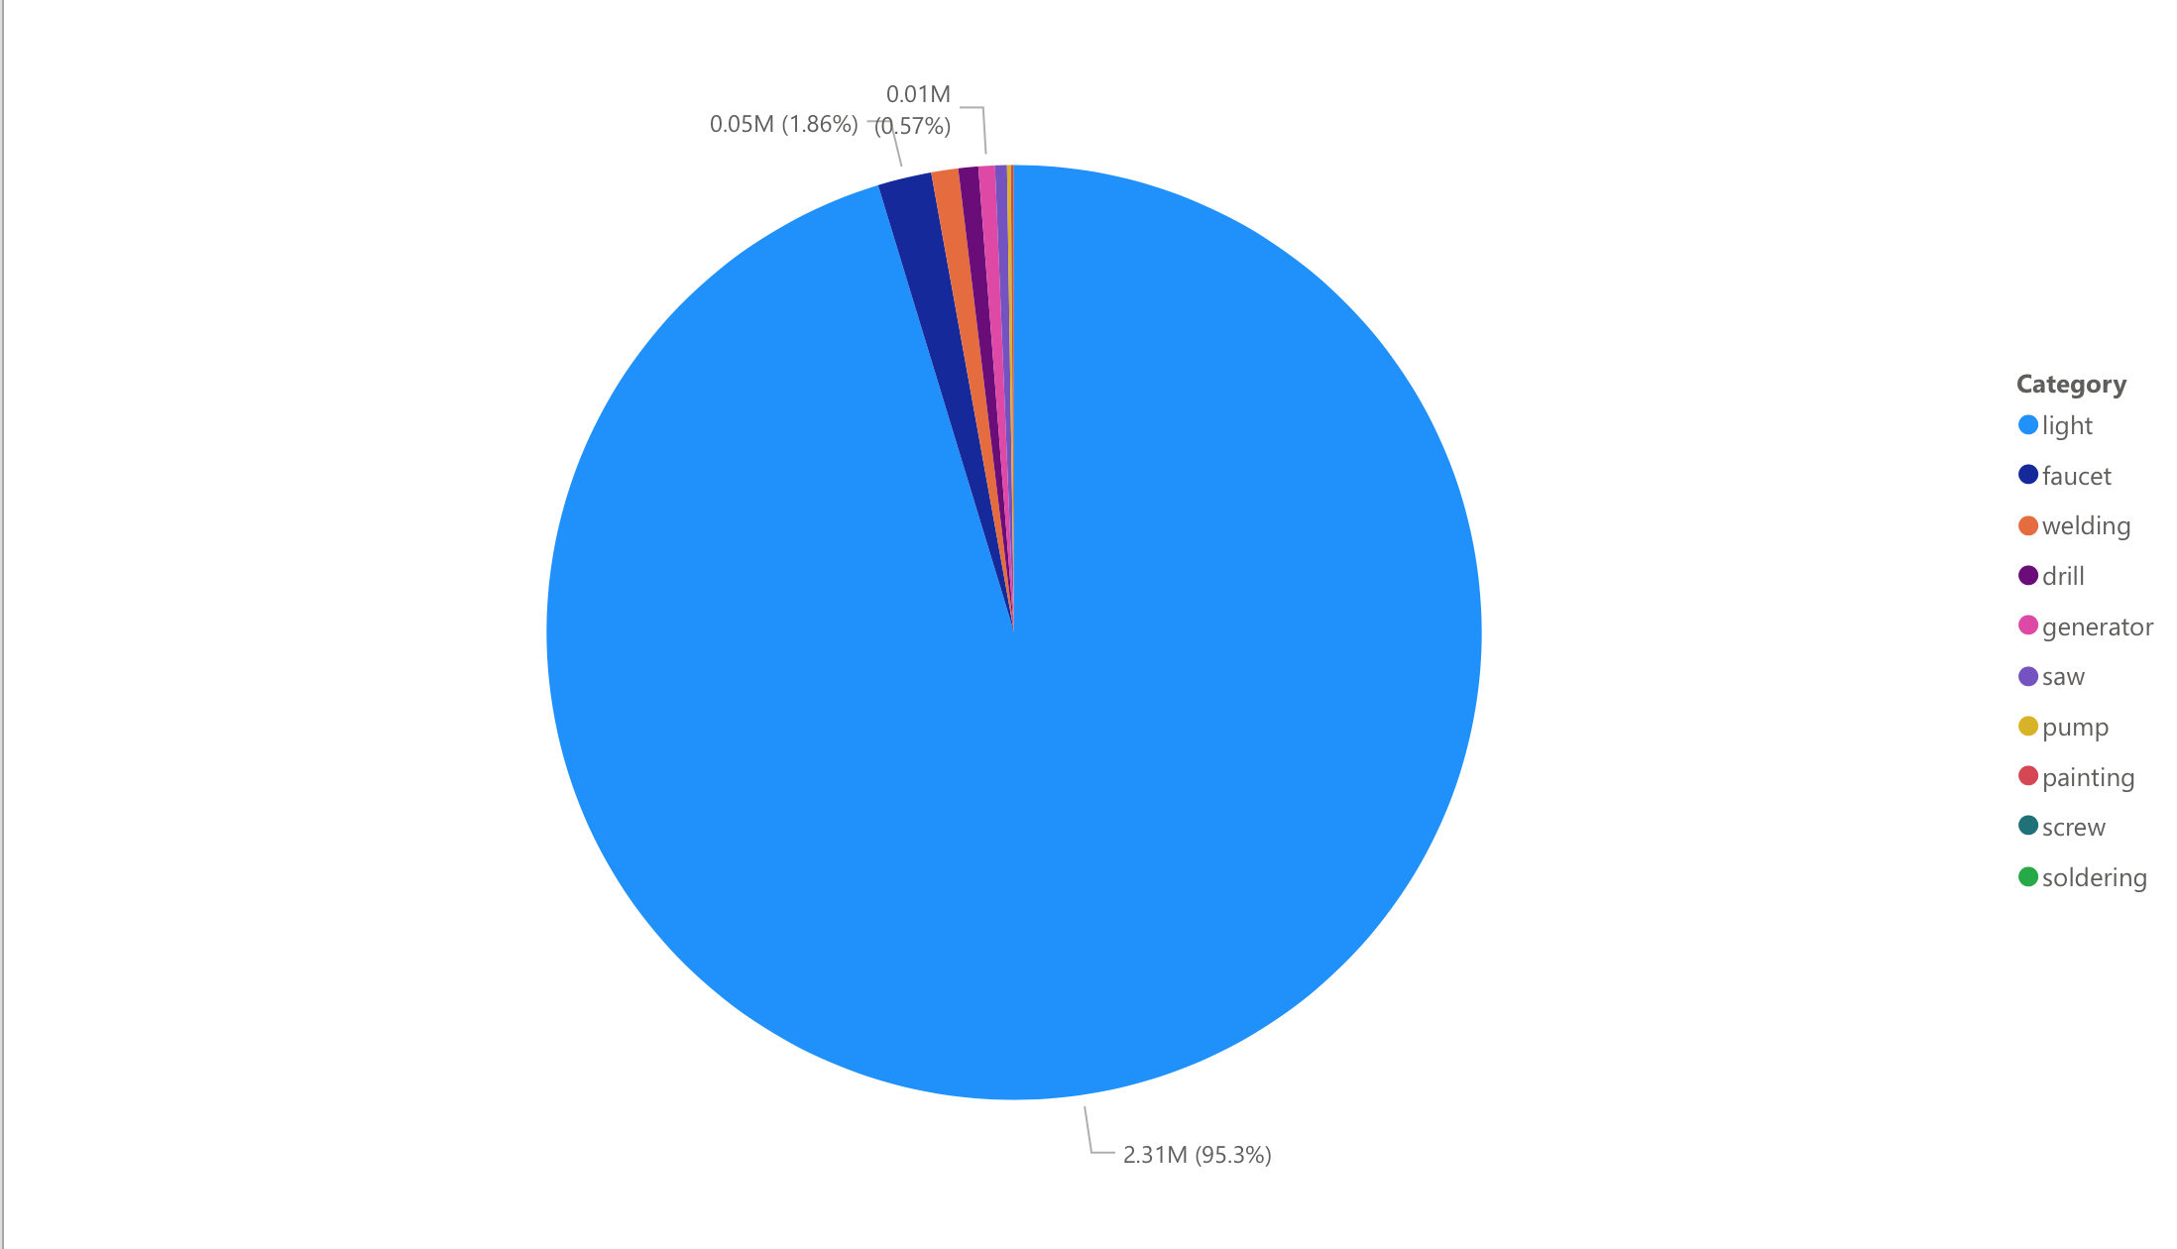
Within construction, 95.3% (2.21 million) of purchases are of lights

Slide 14
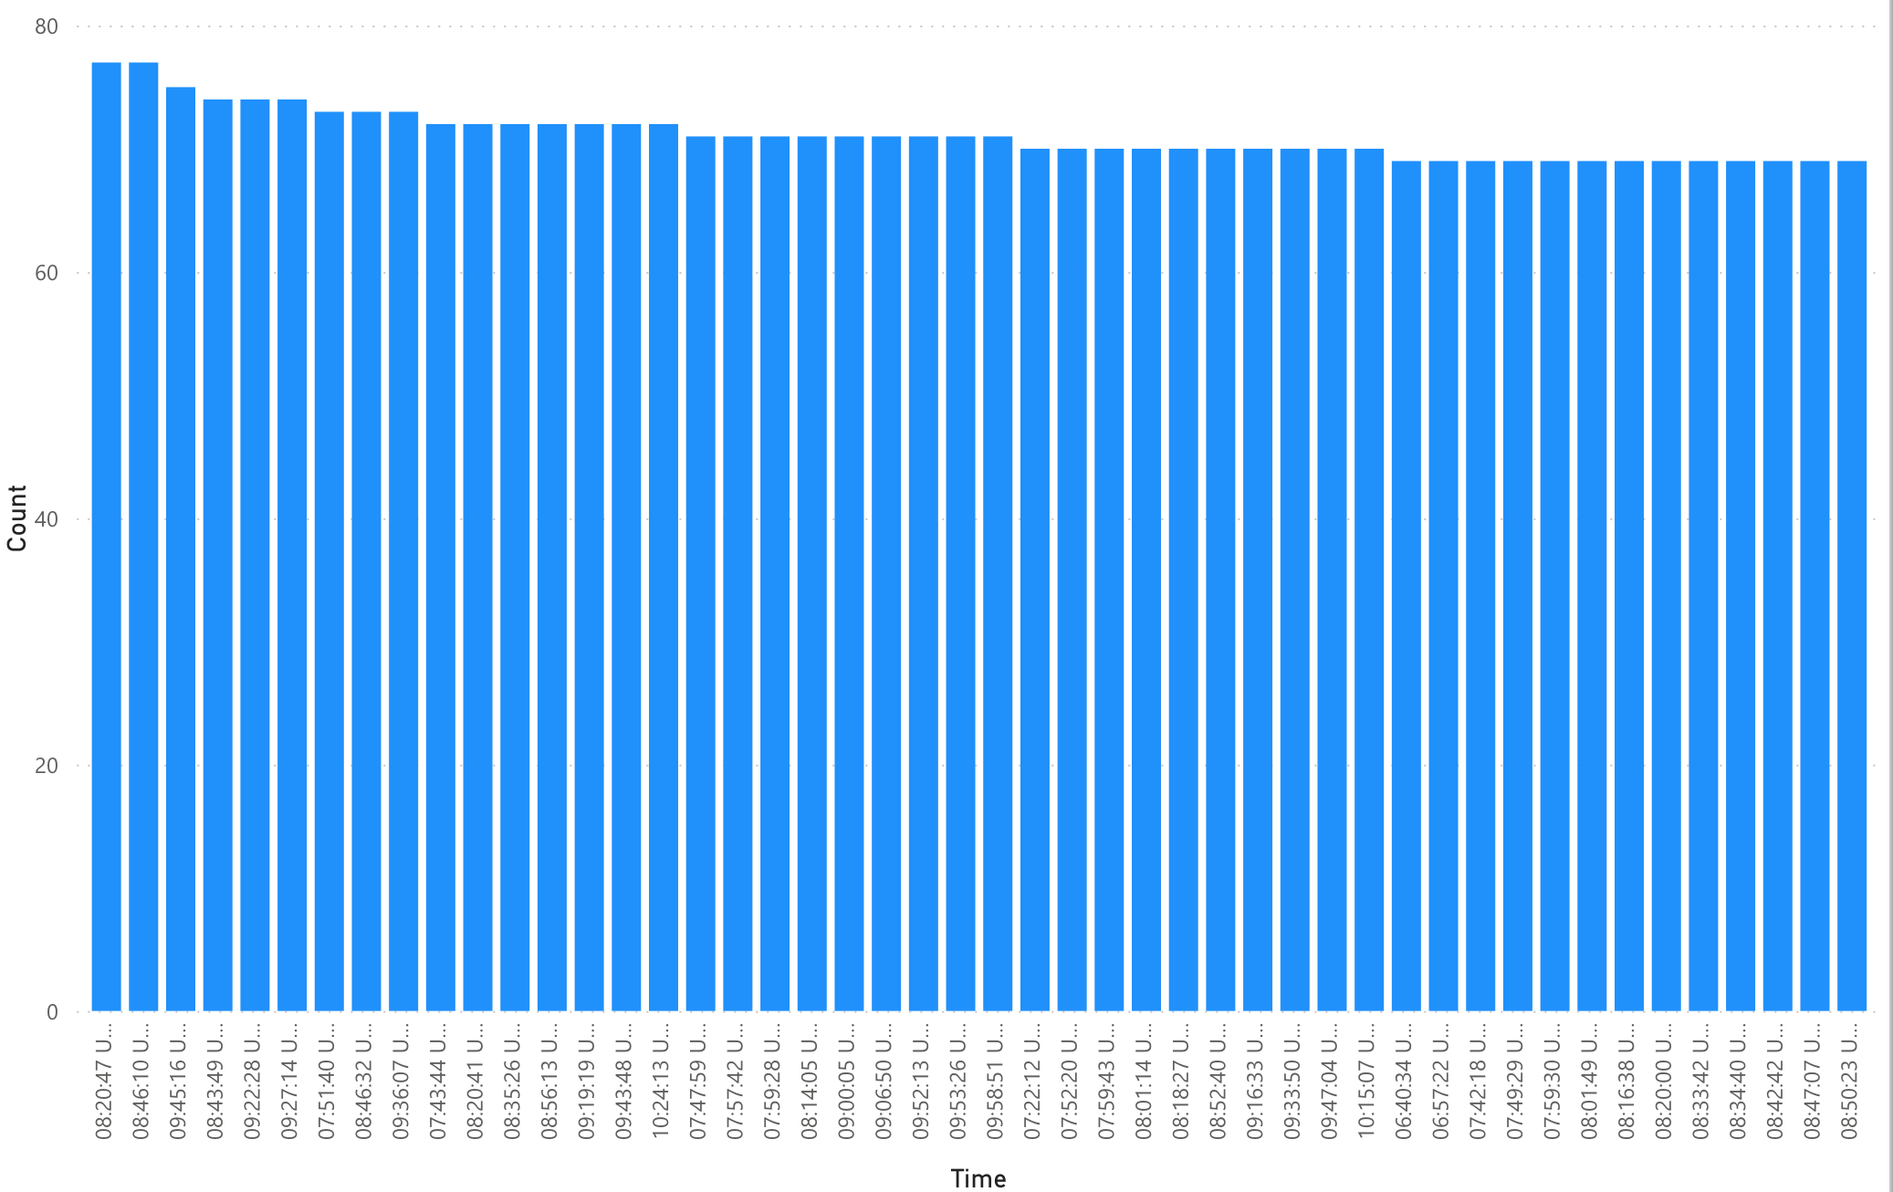
At 8:20AM, most purchases are made.

Slide 15
Conclusion
The role and impact on how e-Commerce has on customer behavior are driving the industry adoption for behavior analysis for attracting more shoppers and improving their shopping experience with an extensive customize cloud-based data analytics and visualization is actually re-inventing “How Businesses conducts Business.”

Slide 16
Github
https://github.com/jramirez162/ecommerce_behavior

Slide 17
References
Fitzegeral, R. (2019, December 10). How Does Social Media Impact Consumer Buying Behavior? Retrieved December 09, 2020, from https://connextdigital.com/how-social-media-impact-consumer-buying-behavior/
Hearn, I. (2019, February 11). 3 Findings That Prove Instagram Drives Shopping Behavior [NEW DATA]. Retrieved December 09, 2020, from https://www.impactplus.com/blog/instagram-drives-shopping-behavior-new-data
Data Sources:
eCommerce behavior data from multi category store. (n.d.). Retrieved December 01, 2020, from https://www.kaggle.com/mkechinov/ecommerce-behavior-data-from-multi-category-store select=2019-Oct.csv
Datasets. (n.d.). Retrieved December 01, 2020, from https://drive.google.com/drive/folders/1Nan8X33H8xrXS5XhCKZmSpClFTCJsSpE
https://journals.sagepub.com/doi/full/10.1177/2056305117706785

